Slide 1
Unit Test - Demo

Slide 2
Convention
Naming the test project: Name of project + .UnitTests
Naming the class source to be tested: ClassName + Tests
Naming the test method : <MethodName>_should_<expectation>_when_<condition>

Slide 3
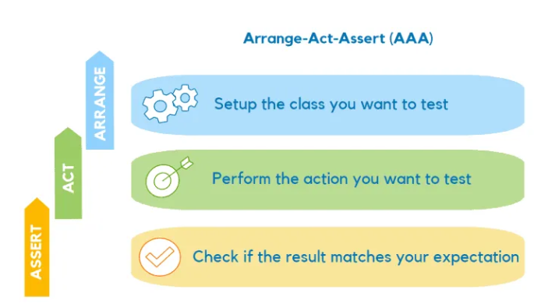
Steps in a unit test function: 3A

Slide 4
External Dependencies ??
Call to external service, database, cache, api, ???
Using mock: để giả lập các đối tượng, hành vi hoặc dữ liệu mà không cần phải sử dụng các thực thể thật => giúp test những phần độc lập với các thành phần phụ thuộc

Slide 5
Unit test Framework
.NET:
Using Xunit , Moq, Smock
Java: junit, mockito, cucumber
Javascript, typescript: Jest, Vi-test
Python: unittest (PyUnit), pytest, parameterized
Flutter: test framework, mockito

Slide 6
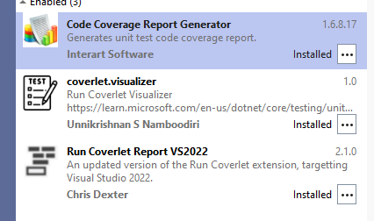
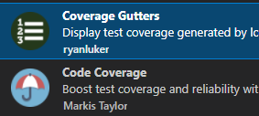
Test and coverage during development
In demo
Extension/Plugin for IDE to show coverage (if default IDE does not support)
After install to use, access Tool menu
For python, if IDE not have plugin coverage, to show coverage, run in active env: $env:PYTHONPATH=“path of source"
coverage run -m unittest discover
coverage html
Visual studio Community | Visual studio code | IntelliJ
 |  | Built-in, Run Test Coverage button or execute test by maven

Slide 7
Best practices for unit tests
- Follow the AAA Model: Keep things easy to read, to recreate and to code!
- Keep it simple
If your test takes more time than writing the feature, it means that perhaps the feature needs some refactoring. It should test only one component or method, not more!
- Test Edge Cases Include tests for both typical and edge cases (e.g., empty inputs, maximum values, null values). Consider testing invalid inputs and boundary conditions.
- Check all possible paths.
Ensure that you have tested all possible inputs, exceptions and loops within the tested method.
Check happy path but also illegal arguments (i.e. nulls, out-of-range…)
- Use Mocking to remove external dependencies
You should not have any dependencies on external objects in your tests, use Mock to simulate them
- Fast: make use of parallelism
Projects will quickly add more and more unit tests, therefore they need to remain lightweight to run fast and not bug down the application.
One way of doing so is by creating more classes
- Minimal
Don’t make too many assertions in one unit test, ideally you’d want one assert per test class
- Meet code coverage target
A typical project aims for 80% code coverage
- Reuse your test object as much as possible using Fixtures
- Use Data-driven test
Create fewer tests and test all your path in one test

